Slide 1
Stand up.
Get involved.
Get Career Ready.
Notes:
Introduce yourself.
Explain your role today: I’m here to share with you some information on Career Ready, a programme that gives students in S5 & S6 the opportunity to gain the key skills you’ll need to succeed after school in the world of work.
Existing school:
Your school has been a partner in the Career Ready programme for some time so other students have already experienced and benefited from the programme. Now it’s your turn to join with over 1,500 other students across the UK who will also be on the programme. Can you be a Career Ready student?
New school:
Your school is a Career Ready partner, which means you get a chance to join with over 1,500 other students across the UK who will also be on the programme. Can you be a Career Ready student?
Over the next 30 minutes you’ll hear about the journey that some of our students have taken and how Career Ready supported them in getting from school studies to a university place or straight into work.

Slide 2
What is this session about?
Introduce you to Career Ready
Help you to understand
  the great opportunity open to you
  the commitment you need to make
  the key elements of the programme
  who the programme is aimed at
Understand how and when to apply
Notes:
Explain what the session will help them to understand.

Slide 3
Introducing Career Ready

Slide 4

Career Ready
Career Ready
Local Authorities Schools
Employers
and You
Bridges
Develops
Partnership
Grows
Confidence
GAP
2 YEARS –
s5 & s6
SCHOOL
WORK
Skills
Attitudes
Networks
Notes:
Career Ready is a national charity working in partnership with local authorities, schools, employers and with students to deliver …
A programme run for two years during S5 & S6 and is for carefully selected students
It bridges the gap between school life and work life
Provides opportunities to gain the skills, attitudes and networks you need to succeed in the workplace / your career
It connects you to employers - more about them soon
You are encouraged throughout and treated with respect so that your confidence grows
Career Ready are passionate about your success and what you can aspire to

Slide 5
“I’ve been a geek all my life – seeing how I could use my weird branch of intelligence in a career was such a revelation. It has made my try harder in school and set me a new direction. It is the best thing I have ever done.”
Scott Labrum (Career Ready student)
“For me, Career Ready has been life changing.. Thanks to Career Ready, I've had the support of my mentor in the Royal Bank of Scotland who has supported me through the most difficult times in my life, and he's helped me achieve many of my goals in life. I've had so much support from the programme and I believe if it wasn't for Career Ready I wouldn't be sitting where I am today. I've loved been involved, and I recommend it to absolutely everyone. It’s an opportunity nobody should ever pass up.”
Morven Petrie (Career Ready Student)

Slide 6
Understanding the key elements of the programme

Slide 7
Mentoring
Masterclasses
Workplace visits
Internships
Events
Notes:
Four elements make up the Career Ready programme. None of these are stand alone and students have to take part in all of them!
Mentoring
You will be partnered with a mentor who is committed to supporting you and is going to give you an insight into the professional world of work. You will meet and communicate with your mentor regularly and they will help you to:
formulate a career plan
identify the skills and qualities that you need to develop in order to increase your employment/higher education chances
develop your confidence in the workplace and strategies to make the best first impression to an employer
Support you in becoming an outstanding networker and build your own professional network of people who can support you in your career journey
Plus many other things!
Masterclasses
Over the duration of the programme, you will take part in 6 masterclasses that will be delivered by employer volunteers, who have stepped up and want to share their experience with you. You’ll take part in sessions such as personal branding, effective networking and communication, interview skills and preparation for work. The result? A more confident, work ready you.
Work place visits
One of the main benefits of Career Ready is that it will give you access to work places that you may not have the opportunity to go to without the programme. You will visit various employers who will give you a chance to find out what it is like to work in their firm and gain an opportunity to speak to people who work there, all the time expanding your own network of contacts who can help you navigate your career choices.
Internships
There is no point hearing about the world of work if you don’t actually get an opportunity to experience it. Over the duration of the programme, all students have a four / five week paid internship. It is at the same workplace as their mentor and starts in the last week of the S5 summer term. They will not be able to take holidays until after their internship is finished. It is real work where you can put the skills you’re learning into practice, find out what work’s really all about, contribute to an organisation and develop your transferable employability skills. Now show them the Standard Life Career Ready video (link)
Events
Launch - meet your mentor for the first time
Celebration of Success – in school after internship with mentors an parents/ guardians
Graduation – in Spring of the second year of the programme

Slide 8
































We work with several hundred employers
Notes:
Career Ready is supported by lots of employers, national and local. Here are just some of them – your future mentor or work placement could be at one of these!

Slide 9

































We work with several hundred employers
Notes:
Career Ready is supported by lots of employers, national and local. Here are just some of them – your future mentor or work placement could be at one of these!

Slide 10
“I would have been completely clueless through my senior years at school without my mentor. I can’t thank her enough.”
Akram Miah (Career Ready student)

Slide 11
“There is the mistaken belief that there are no opportunities out there for young people. The Career Ready programme in itself is a massive opportunity to make connections, learn about work, gain experience and to help figure out what it is you want to do in the future.”
Shawnie Wright , Career Ready student

Slide 12

Get the most from your mentor.
Discuss. Listen. Act.
Notes:
Mentoring is one part of the programme which our students say transforms their thinking about careers and work more than anything else. But mentoring is a two way street. The mentor isn’t there to tell you what to do but helps you to understand your options, work through how to make decisions and support you in fulfilling your potential. They can only do this if you are fully committed. The result: a professional relationship which often continues long after the Career Ready programme finishes.
Explain you are going to play a short film clip made by career ready interns at Standard Life and they will hear about all aspects of the programme. https://www.youtube.com/watch?v=WHrMzg1AIFs

Slide 13
Who is it for?

Slide 14
Who is it for?
Are in S5, on track to achieve at least one, and likely two or three Highers
Are available and eligible to complete the paid internship in the summer holiday between S5 and S6 (no holidays booked then)
Lack the networks and confidence to pursue their goals
May be the first in their family to consider university
Have their parents’/carers’ agreement to apply
Have the right to work in the UK
Students who:
Will commit to the two year programme
Plan to stay in school until end of S6, but may be unclear what to do after S6
Have the desire to make the most of the opportunity, in addition to schoolwork and commitments outside school
Are willing to develop a great relationship with their mentor AND meet them at least twice a term, in their mentor’s workplace
Notes:
Say there is a lot here but it is important for them to know this.
Explain typical Career Ready students are those who traditionally haven’t got access to the professional world of work through their own social networks and would benefit from the access and open doors which the programme provides. They are students who can pass exams and complete their course work, and the interventions from our programme helps them do even better. Our students sometimes start the programme with little confidence but grow into confident, mature and professional Career Ready graduates.
Give out the A5 flyer “ Step into the world of work”

Slide 15
Will you be Career Ready?
Do you want to explore your options for after school?
Have you got the motivation to commit to the programme throughout S5 & S6, alongside your studies?
Will you make the most of a mentor and meet with them, in their workplace, regularly?
Are you willing to be pro-active to take up the opportunities that the programme provides?
Will you commit some of your summer holidays to completing internships?
Are you up for up for a fantastic experience with will put you on the right track?
Notes:
Ask Will you be Career Ready? Are you committed, motivated and willing to be proactive?

Slide 16
“Career Ready has given me an insight of different career paths, as before I had quite a narrow minded approach to what I wanted to do in the future. At least now I know what’s out there.”
Liam Cleeton (Career Ready student)

Slide 17
Get Career Ready.
Apply today.
www.careerready.org.uk
Notes:
Ask them to ask themselves “what can Career Ready do for me?”
Suggest they look at the website
Discuss it with their family/ guardians
Speak to their school coordinator
Speak to other students at the school who have been on the programme if they can.
Talk them through to the application process below
Online application form
Teachers review the applications and identify students to shortlist for an interview
Teachers and employers will interview them
Students offered a place

Slide 18
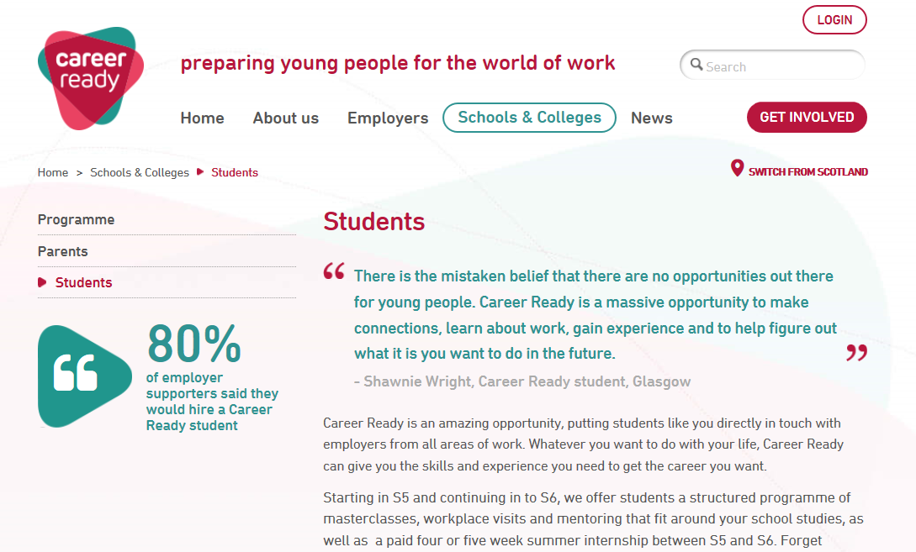
On our website
Notes:
Tell them this is the Scotland page for School then Students and they need to switch to this from the England Wales & NI page – this page tells them about the programme and will remind them aout what they have heard to day.

Slide 19
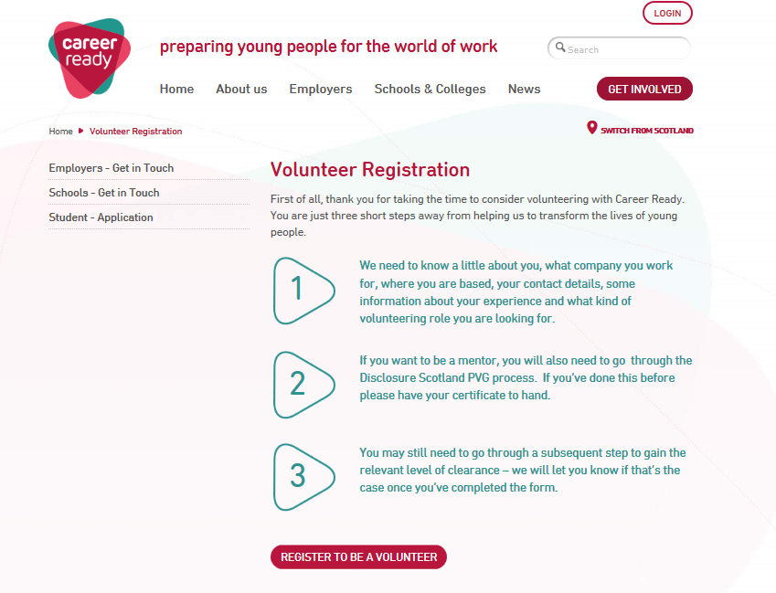
Where to register
Notes:
Explain they register on line and it is a user friendly process which they will find easy to follow

Slide 20
Ask your Coordinator for help if you need it
www.careerready.org.uk
Notes:
If you have any further questions, speak to your school coordinator about how you can get involved.
Finally any last questions if not say say good bye and thank them for coming along

